Slide 1

NONADIABATIC DYNAMICS OF PHOTOINDUCED PROTON-COUPLED ELECTRON TRANSFER
PUJA GOYAL
Workshop on
Modular Software Infrastructure for Excited State Dynamics
June 10, 2018

Slide 2
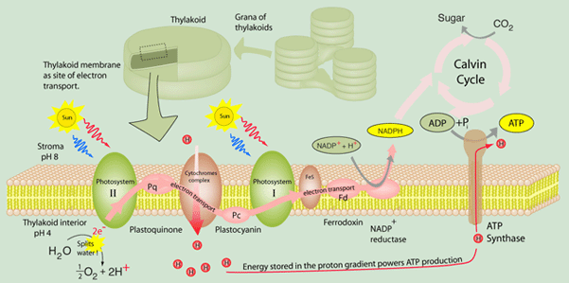
The Light-Dependent Reactions in Photosynthesis
Photoinduced charge separation drives redox reactions.
http://hyperphysics.phy-astr.gsu.edu/hbase/biology/psetran.html

Slide 3
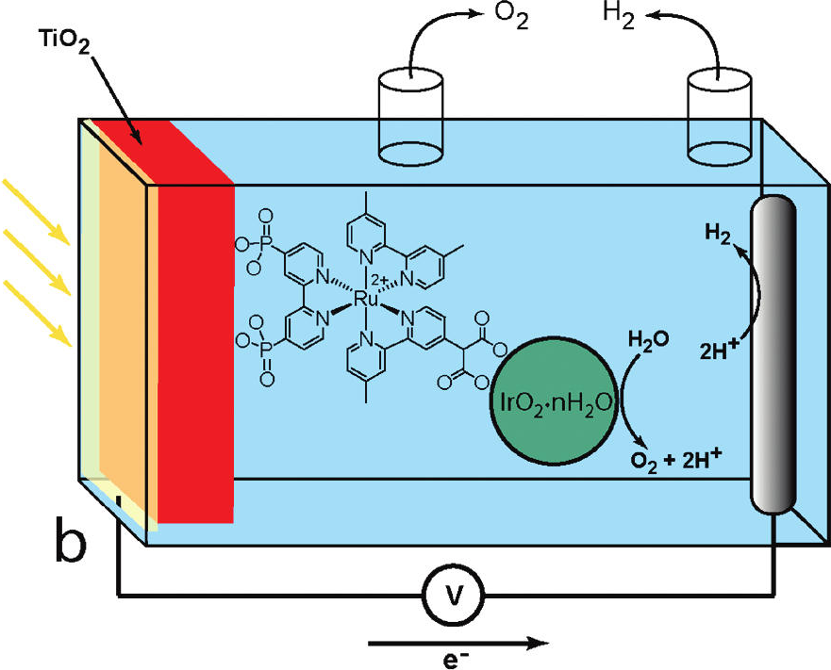
Learning from Nature
Fuel production via
“artificial photosynthesis”
in a
photoelectrochemical cell
Gust, Moore, Moore Acc. Chem. Res. 2009

Slide 4
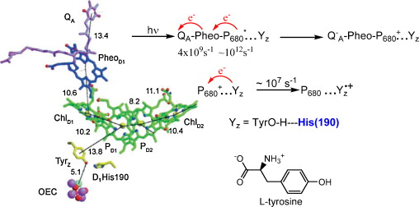
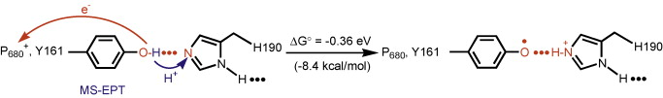
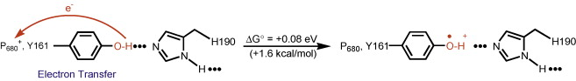
PCET in Photosystem II
Gagliardi, Westlake, Kent, Paul, Papanikolas, Meyer Coord. Chem. Rev. 2010

Slide 5
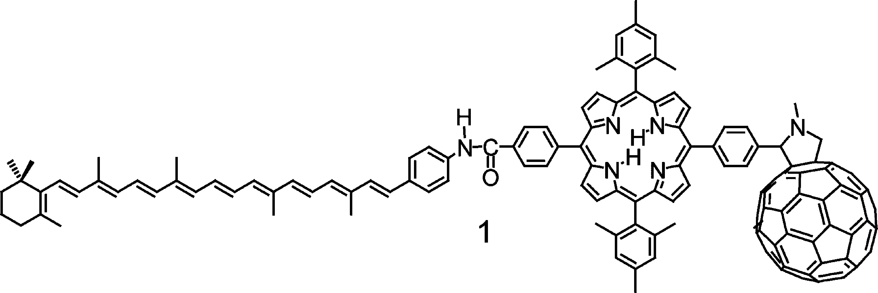
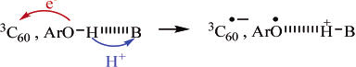
Learning from Nature
Fuel production via
“artificial photosynthesis”
in a
photoelectrochemical cell
Photoinduced ET
Photoinduced PCET
e⁻
e⁻
Non-equilibrium dynamics of photoinduced PCET not well-understood.
Gust, Moore, Moore Acc. Chem. Res. 2009
Concepcion et al., Papanikolas, Meyer JACS 2007

Slide 6
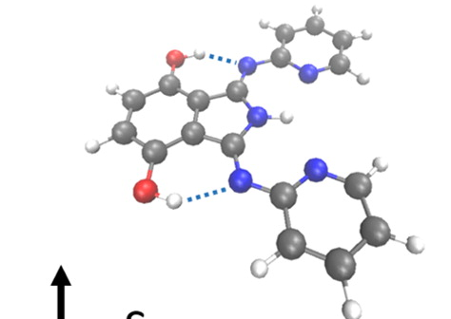
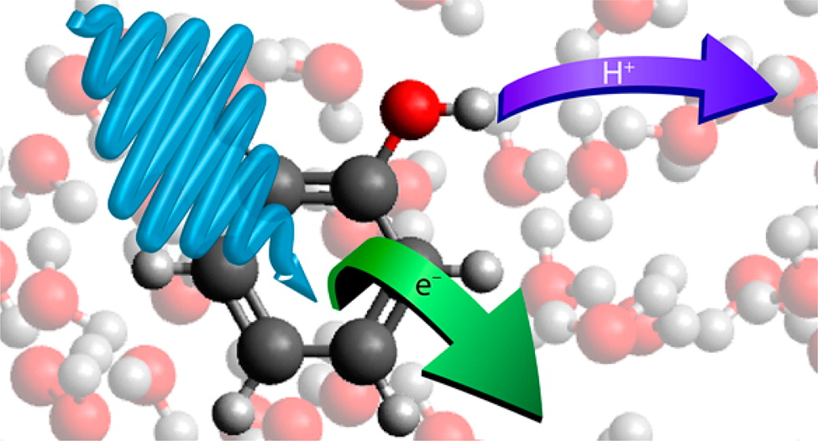
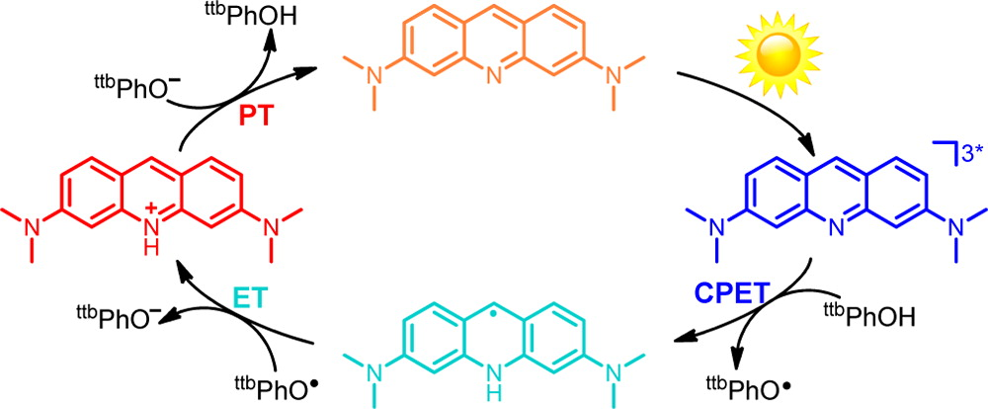
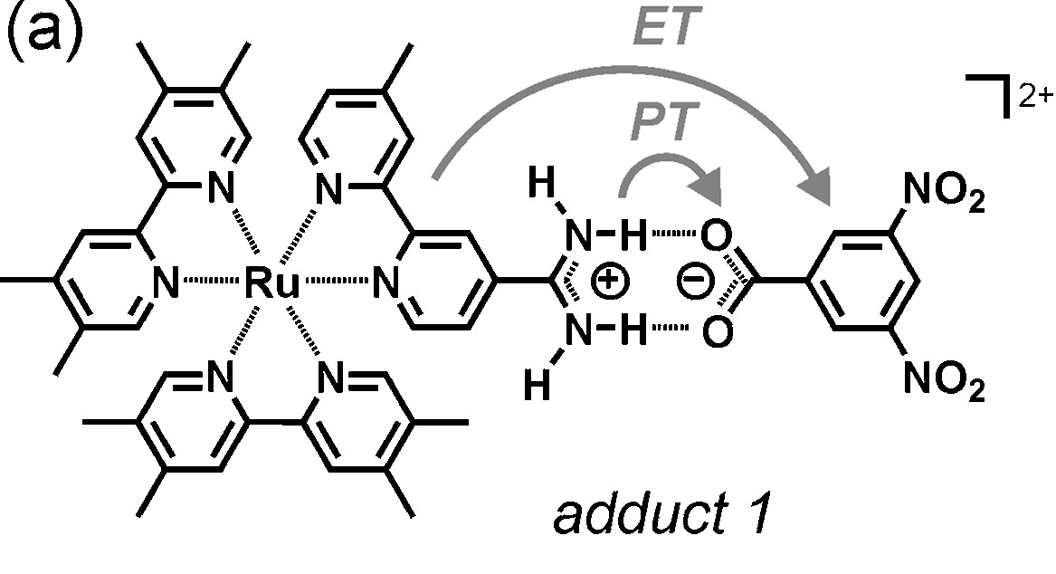
Photoinduced PCET in Model Systems
e⁻, H⁺
Driscoll, Sorenson, Dawlaty JPC A 2015
Oliver, Zhang, Roy, Ashfold, Bradforth JPC Lett. 2015
Eisenhart and Dempsey JACS 2014
Wenger Coord. Chem. Rev. 2015

Slide 7
Fundamental Questions
What factors are important in facilitating PT on an excited electronic state with charge transfer character?
Does PT affect the relaxation dynamics of the system?
Can H/D isotope effects provide evidence of the occurrence of PT?
-- amenable to theoretical/computational studies

Slide 8
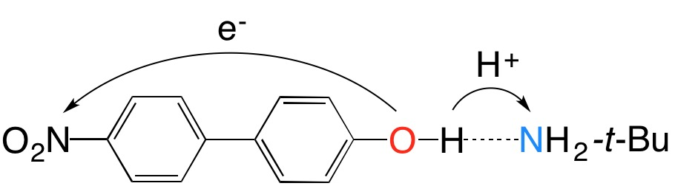
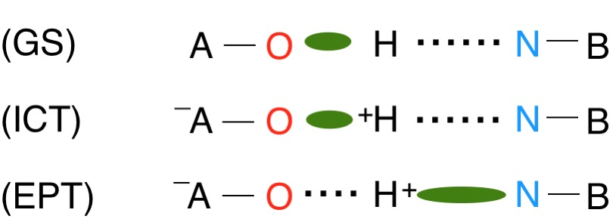
Photoinduced Concerted
Electron Proton Transfer (EPT)
Femtosecond transient absorption spectra and coherent Raman spectra used to demonstrate EPT mechanism
Coherent Raman spectrum interpreted to indicate PT
upon vertical excitation – debatable.
in 1,2-dichloroethane solution
Westlake et al., Meyer, Papanikolas PNAS 2011
Our goal: Study the time evolution of the system in order to understand and complement experimental data.
Approach: On-the-fly nonadiabatic dynamics

Slide 9
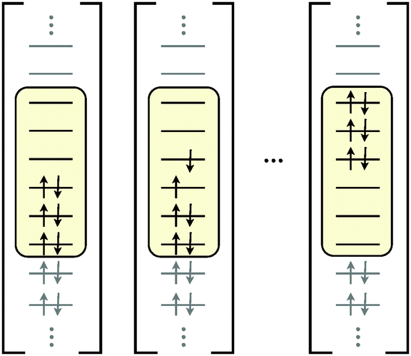
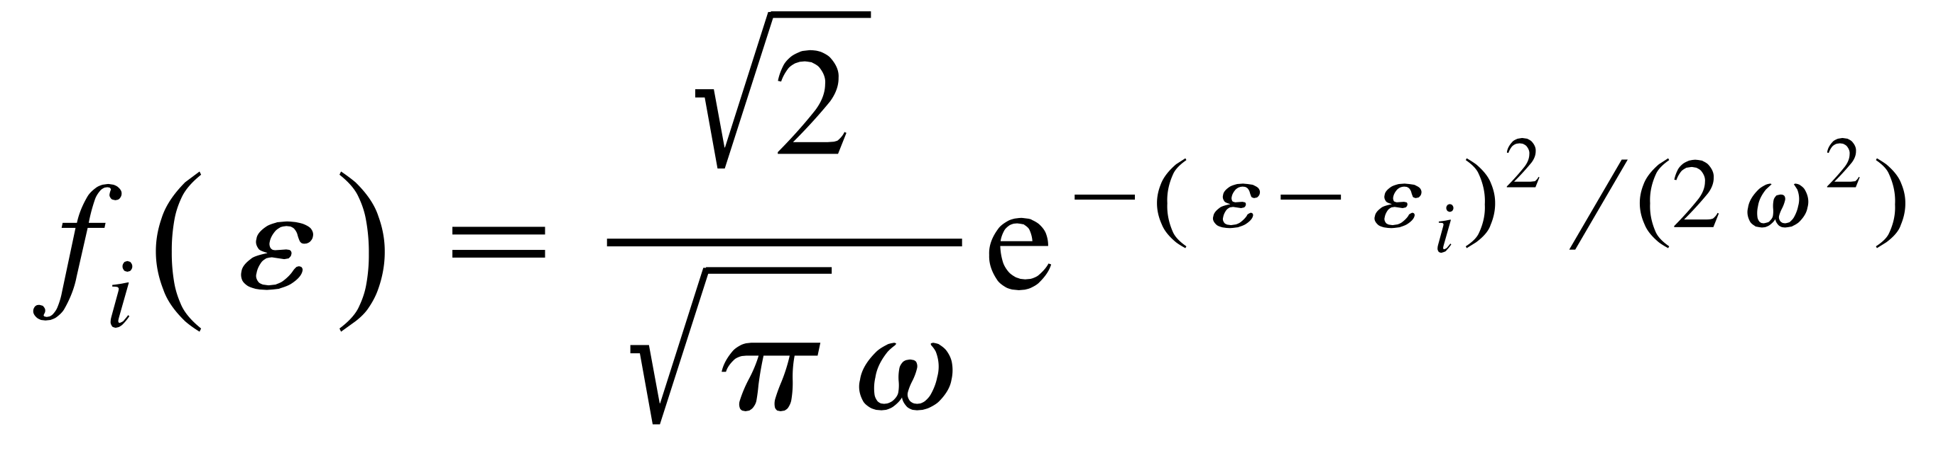
Calculation of Solute Electronic States
Configuration interaction (CI):
Choose an active space of orbitals and electrons
CASSCF: Optimize the molecular orbital (MO)
and CI coefficients
CASCI: Optimize only the CI coefficients
Floating occupation molecular orbital (FOMO)-SCF provides good orbitals for CASCI calculations
Excited electronic states generated with semiempirical FOMO-CASCI
Granucci, Toniolo CPL 2000
Gozem et al. Chem. Soc. Rev. 2014

Slide 10
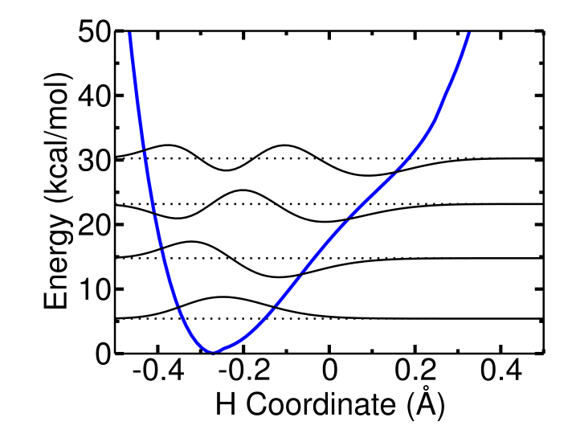
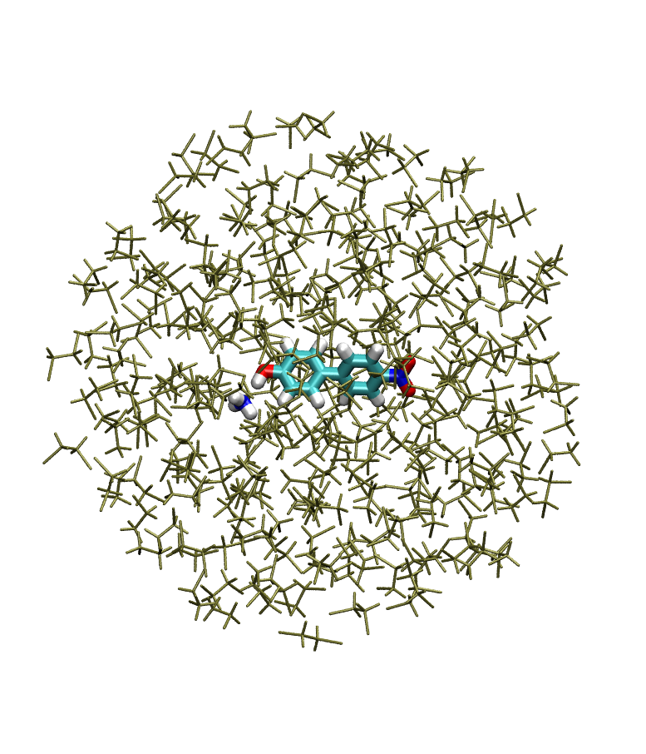
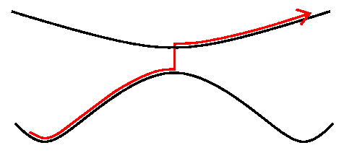
Overall Procedure
Fit PM3 parameters to get agreement between
PM3/FOMO-CASCI and reference CASPT2 data
Characterize the solute electronic states using CASPT2/CASSCF
Surface hopping
Calculate electronic/vibronic states
Quantum mechanics/
molecular mechanics (QM/MM)
Tully JCP 1990
Hammes-Schiffer, Tully JCP 1994
QM/MM semi-empirical FOMO-CASCI code: Prof. Todd Martinez
MDQT implementation: Dr. Christine A. Schwerdtfeger

Slide 11
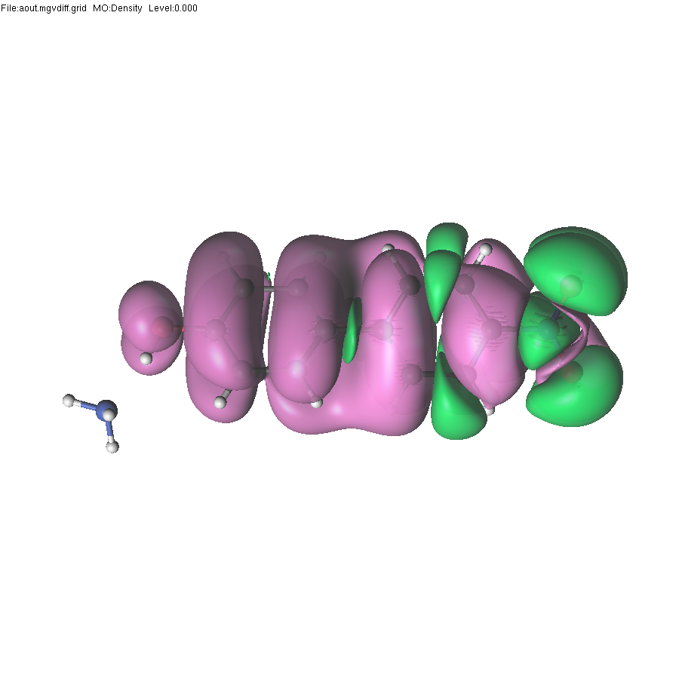
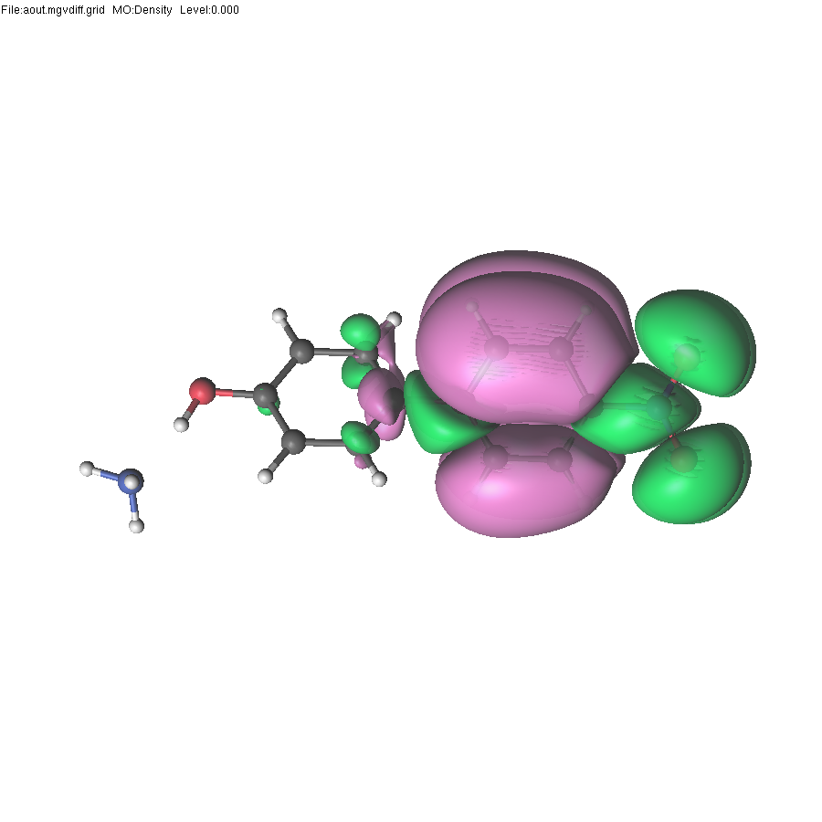
CASSCF/CASPT2 Characterization of
Electronic States
t-butylamine replaced with ammonia for more efficient high-level computations.
positive in green,
negative in pink
S₀→S₁
S₀→S₂
Electronic density difference between S₁/S₂ and S₀ at the FC geometry
 | MS-4SA-CAS(10,10)PT2 |  |  | MS-5SA-CAS(14,14)PT2 |  |  | TD-CAM-B3LYP
 | f | E_{exc} (eV) | (Debye) | f | E_{exc} (eV) | (Debye) | f | E_{exc} (eV) | (Debye)
S₀ |  |  | 9.0 |  |  | 8.3 |  |  | 9.9
S₁ | 0.3677 | 4.46 | 22.2 | 0.6715 | 4.46 | 18.5 | 0.5349 | 4.04 | 20.5
S₂ | 0.0294 | 5.22 | 15.6 | 0.0328 | 5.19 | 13.3 | 0.0117 | 4.73 | 13.6
Dipole moments are from CASSCF calculations
Goyal, Schwerdtfeger, Soudackov, Hammes-Schiffer JPC B 2015

Slide 12
Reparameterization Procedure
Data included in the target function for reparameterization:
Optimized geometry on the S₀ state
Vertical excitation energies for S₁ and S₂ at the FC geometry
Proton potential energy curves at different N-O distances
Potential energy as a function of the N-O distance
Potential energy as a function of the “twist” angle
RMSD between MP2 and
R2PM3 geometry on S₀: 0.296 Å
 | E_{exc} (eV)
 | MS-4SA- CAS(10,10)PT2 | R2PM3 FOMO-CASCI
S₁ | 4.46 | 4.35
S₂ | 5.22 | 5.21
Proton potential energy curves at r_{NO}=2.8 Å
Toniolo, Thompson, Martinez Chem. Phys. 2004
Goyal, Schwerdtfeger, Soudackov, Hammes-Schiffer JPC B 2015

Slide 13
Reparameterization code
Simplex code hooked up to
MOPAC: semi-empirical FOMO-CASCI calculations
CHARMM: RMSD calculation
For ~40 PM3 parameters and ~20 target properties, parameter fitting takes ~1 day.

Slide 14
QM/MM Simulations
Solvent sphere of radius 20 Å around complex
Soft restraining potential on solvent molecules at the boundary
General Amber Force Field for solute Lennard-Jones parameters and for solvent
Solute described with semiempirical FOMO-CASCI
Solvent: 1,2-dichloroethane
Goyal, Schwerdtfeger, Soudackov, Hammes-Schiffer JPC B 2015

Slide 15
Code details
MOPAC code interfaced with AMBER for QM/MM
Umbrella sampling on excited electronic states
Molecular dynamics with quantum transitions (MDQT) method for surface hopping
Numerical derivative couplings, except at hops where analytical couplings are calculated
3 electronic states, 29 QM atoms, 2035 MM atoms, 5 ps in ~12 hours

Slide 16
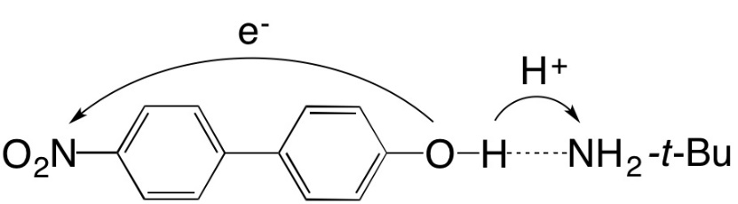
Free energy profiles for PT in solution
QM/MM umbrella sampling simulations along proton transfer coordinate on each state
Solvent: 1,2-dichloroethane
S₀, S₂(ICT): minimum for proton at O
S₁(EPT): minimum for proton at N
PT barrier ~4 kcal/mol
PMF: Potential of mean force (free energy)
Goyal, Schwerdtfeger, Soudackov, Hammes-Schiffer JPC B 2015

Slide 17
Molecular Dynamics with Quantum Transitions
Time-independent Schrodinger equation:
Time-dependent wave function:
← Quantum probability of Born-Oppenheimer state ‘n’
In addition to the classical coordinates,
TDSE coefficients need to be propagated
with time
Hamiltonian matrix element
Velocity vector
Non-adiabatic coupling vector
EPT
Tully JCP 1990
Hammes-Schiffer, Tully JCP 1994

Slide 18
MDQT Simulations with a Classical Proton
Initial coordinates and velocities for the solute include zero point energy
Solvent velocities corresponding to 296 K
A total of ~460 trajectories photoexcited to either S₁ or S₂
Photoexcitation to S₁
Decay from S₂ to S₁ occurs essentially within 100 fs (Experiment: < 1 ps, limited resolution)
Decay of S₁ occurs with τ~0.9 ps
(Experiment: τ~4.5 ps)
Photoexcitation to S₂
Goyal, Schwerdtfeger, Soudackov, Hammes-Schiffer JPC B 2015

Slide 19

Excited State Proton Transfer
Experiments did not provide clear evidence of PT on S₁
~54% of all MDQT trajectories exhibit PT on S₁
Decay from S₂ to S₁ followed by PT
from O to N on S₁
PT from N to O upon transition to S₀
Conical intersection between S₁ and S₀
Goyal, Schwerdtfeger, Soudackov, Hammes-Schiffer JPC B 2015

Slide 20
Fundamental Questions
What factors are important in facilitating PT on an excited electronic state with charge transfer character?
Does PT affect the relaxation dynamics of the system?
Can H/D isotope effects provide evidence of the occurrence of PT?
positive in green,
negative in pink
S₀→S₁
S₀→S₂

Slide 21
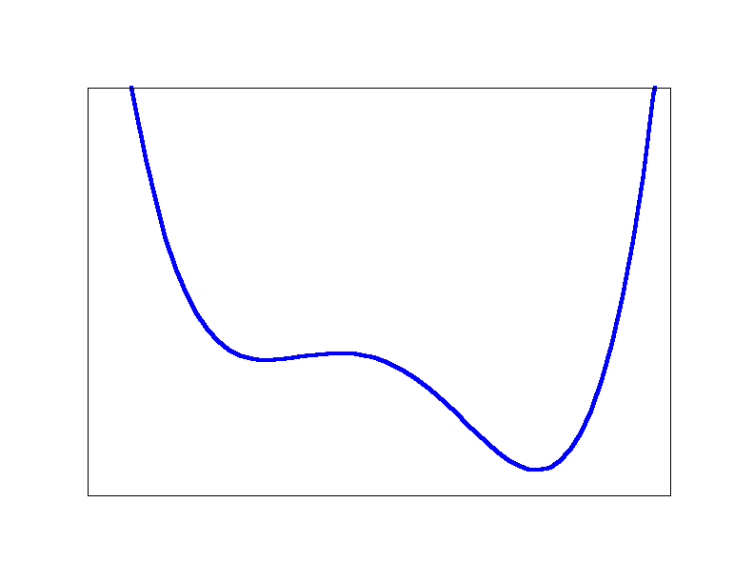
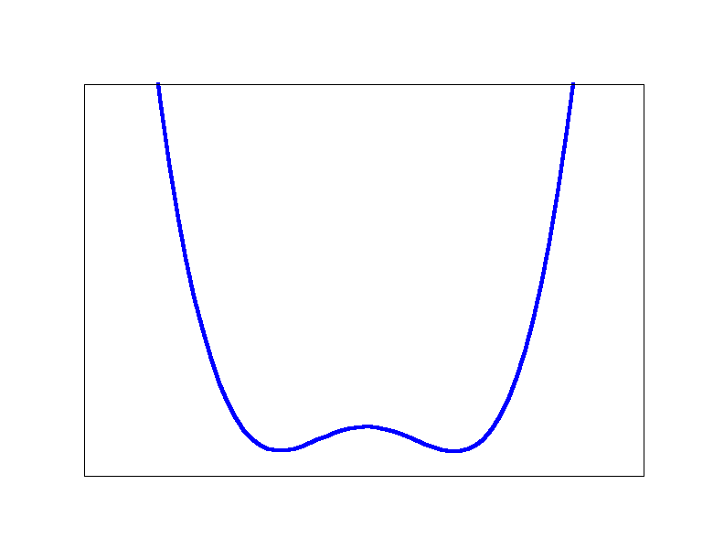
Effects of Solvent Dynamics
Generates electrostatic environment conducive to
PT on S₁
Decreases S₀/S₁ energy gap,
facilitating decay to S₀
t=0 fs
t~310 fs
PT coordinate
O-----------N
PT coordinate
O-----------N
Proton transfer is not instantaneous – it requires solvent reorganization (~250 fs)
Goyal and Hammes-Schiffer, JPC Lett. 2015

Slide 22
Fundamental Questions
What factors are important in facilitating PT on an excited electronic state with charge transfer character?
Solvent relaxation, solute hydrogen-bonding interface
Does PT affect the relaxation dynamics of the system?
PT can provide a pathway for decay to the ground state
Can H/D isotope effects provide evidence of the occurrence of PT?
positive in green,
negative in pink
S₀→S₁
S₀→S₂

Slide 23
Quantum Treatment of Proton
Proton represented quantum mechanically along 1D grid (O-N axis)
S₀
Proton potential
Energy
Ground vibrational w.f.
Electronic structure calculation at each gridpoint
Proton coordinate, r_{p}
O
N
Marston, Balint-Kurti JCP 1989
Soudackov, Hammes-Schiffer CPL 1999
Sirjoosingh, Hammes-Schiffer JPC A 2011

Slide 24
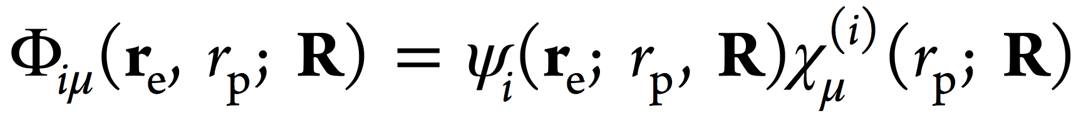
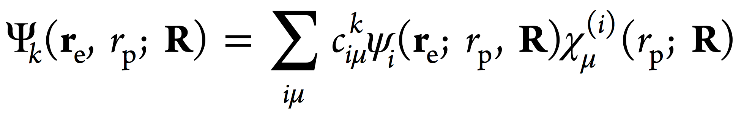
Quantum Treatment of Proton
Proton represented quantum mechanically along 1D grid (O-N axis)
Double adiabatic vibronic state:
Each proton potential corresponds
to an adiabatic electronic state
Calculate vibronic states in the basis of products of electronic eigenfunctions and corresponding proton vibrational eigenfunctions.
Adiabatic vibronic state:
Marston, Balint-Kurti JCP 1989
Soudackov, Hammes-Schiffer CPL 1999
Sirjoosingh, Hammes-Schiffer JPC A 2011

Slide 25
Quantum proton code details
One-dimensional Fourier Grid Hamiltonian (FGH) method for calculation of vibrational states corresponding to each electronic state
Electronic structure calculation at each grid point on a different processor → gives the proton potential for each electronic state
Calculation of gradients on vibronic states and derivative couplings between vibronic states parallelized
Surface hopping on vibronic states
Norm-preserving interpolation scheme for calculation of electronic couplings, except at hops where full analytical coupling is calculated.
Ability to restart trajectories
Marston, Balint-Kurti JCP 1989
Meek, Levine JPCL 2014

Slide 26
Modeling Photoexcitation for Quantum Proton
Proton potentials
Energy
r_{p}
Equilibrate system to ground proton vibrational state in S₀
Photoexcite to S₁ according to Franck-Condon overlaps of proton states
Proton potentials for S₀ and S₁ are similar initially
Populate mainly ground proton vibrational state of S₁
Run many independent trajectories to sample equilibrium distribution of
initial solute/solvent configurations
Goyal, Schwerdtfeger, Soudackov, and Hammes-Schiffer, JPC B 2016

Slide 27
Analysis of Proton Transfer
Define proton transfer in terms of <r_{p}>: can occur on S₁ or S₀
Analyze proton potentials (energy versus proton coordinate r_{p})
28% on S₁
Solvent
reorganization flips asymmetry of proton potential and reduces PT barrier
initial
at PT
33% on S₀
Small solvent fluctuations shift delocalized proton wavefunction
toward acceptor
initial
at PT
Goyal, Schwerdtfeger, Soudackov, and Hammes-Schiffer, JPC B 2016

Slide 28
H/D Isotope Effect
No H/D isotope effect observed for relaxation to ground vibronic state
On S₁: asymmetry of proton potential flips
On S₀: excited vibrational states highly delocalized for H and D
Vibrational relaxation process does not involve tunneling between
localized states
Photoexcitation to S₁
Absence of isotope effect does not imply
absence of PT in photoinduced PCET!
Photoexcitation to S₂
Goyal, Schwerdtfeger, Soudackov, and Hammes-Schiffer, JPC B 2016

Slide 29
Fundamental Questions
What factors are important in facilitating PT on an excited electronic state with charge transfer character?
Solvent relaxation, solute hydrogen-bonding interface
Does PT affect the relaxation dynamics of the system?
PT can provide a pathway for decay to the ground state
Can H/D isotope effects provide evidence of the occurrence of PT?
Not necessarily
positive in green,
negative in pink
S₀→S₁
S₀→S₂

Slide 30
Summary
Developed methods for photoinduced PCET:
on-the-fly nonadiabatic dynamics with surface hopping on vibronic surfaces
Elucidated roles of nonequilibrium solvent, solute, and charge transfer
dynamics, as well as vibrational relaxation
Determined detailed mechanisms, decay rates, H/D isotope effects
Goal: tune PCET systems to control charge dynamics and relaxation

Slide 31
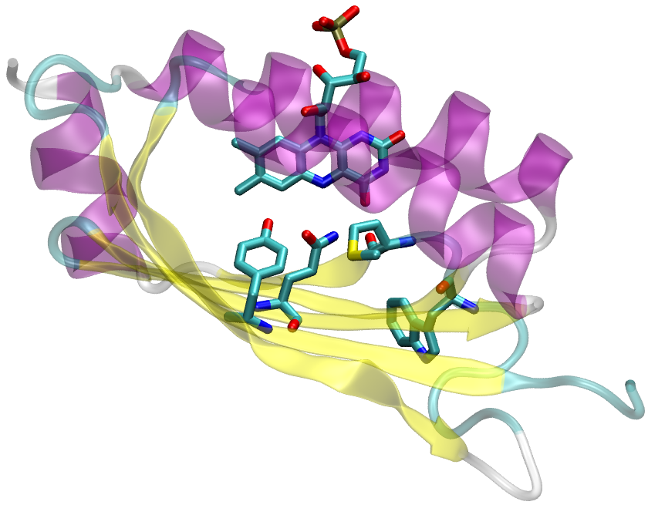
Future developments
Three-dimensional FGH and multiple quantum protons
Ewald summation for PBC; MOPAC interfaced with CHARMM; needs to be fully tested and applied to a real system
Methods to model transition metal photochemistry
e⁻
H⁺
Goyal and Hammes-Schiffer, PNAS 2017

Slide 32
Acknowledgements
Prof. Sharon Hammes-Schiffer
Dr. Alexander V. Soudackov
Dr. Christine A. Schwerdtfeger
Prof. Todd Martinez
AFOSR, Blue Waters

Slide 33
Interpretation of Relaxation Process
Population decay from S₁ to S₀ faster with quantum proton
Population rise of ground vibronic state similar timescale as classical proton
τ~0.6 ps
Transient absorption experiments: ~4.5 ps timescale interpreted as S₁ to S₀
Calculations suggest experimental timescale includes relatively fast
decay from S₁ to S₀ followed by vibrational relaxation within S₀
Goyal, Schwerdtfeger, Soudackov, and Hammes-Schiffer, JPC B 2016

Slide 34
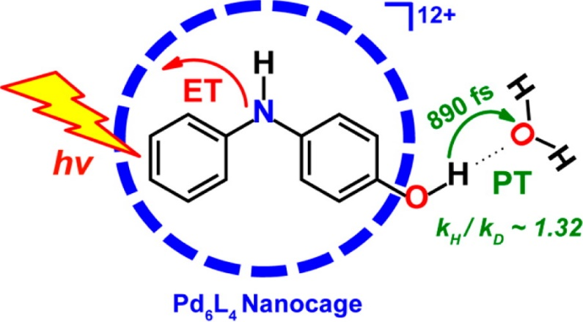
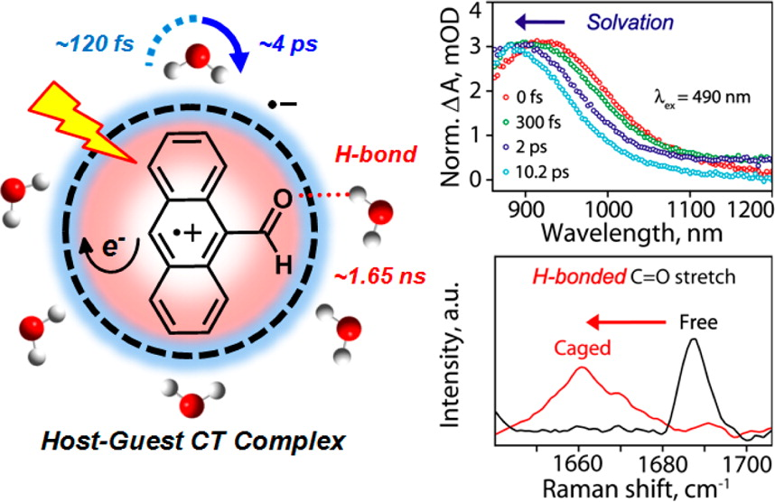
Solvent Dynamics and Proton Transfer
Solvent relaxation also found to be the predominant reaction coordinate for PT inside a nanocage.
PT facilitated by solvent reorganization
Dasgupta and coworkers, JACS, 2014
Solvent relaxation stabilizes
CT state
Dasgupta and coworkers, JPCC, 2015

Slide 35
Substituent and Solvent Effects
Hammett constant of substituent impacts dipole moment change
Effect is greater for the excited electronic state: impacts Δμ
Investigating impact of substituents and solvent on dynamics
TDDFT/CAM-B3LYP/6-31+G(d)
Alter timescale of relaxation to ground state
Alter timescale and probability of PT
Related linear correlations: Driscoll, Hunt, Dawlaty, JPCL 2016

Slide 36
Relation of Photo-EPT to PT and ET
Photo-EPT: large change in dipole moment as
well as shift in charge density at PT interface
→ solvent dynamics required to facilitate PT
Excited state PT: much smaller change in dipole
moment → solvent dynamics less important,
proton quickly slides down to minimum
Excited state ET: similar timescale (100−200 fs) first solvation shell solvent dynamics observed experimentally and computationally
(Maroncelli, Fleming, and coworkers)

Slide 37
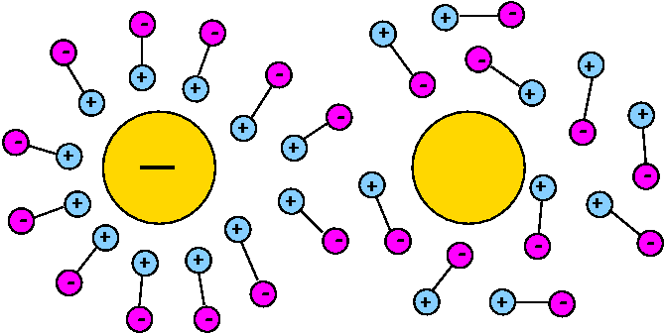
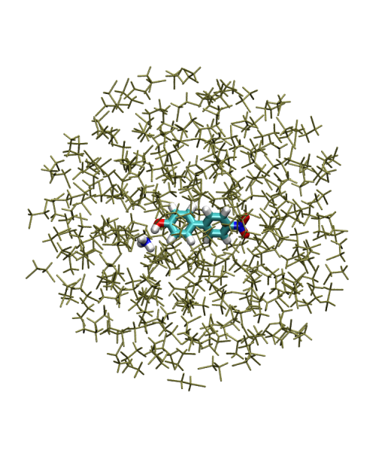
Analysis of Solvent Dynamics
Photoexcitation alters dipole moment of solute molecule
Solvent relaxation, mainly first solvation shell, occurs within ~250 fs
solvent equilibrated to ground state
Δμ = 13 D
Goyal and Hammes-Schiffer, JPC Lett. 2015

Slide 38
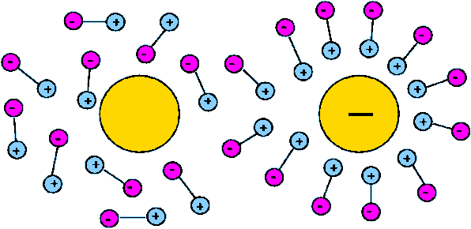
Analysis of Solvent Dynamics
Photoexcitation alters dipole moment of solute molecule
Solvent relaxation, mainly first solvation shell, occurs within ~250-300 fs
Δμ = 13 D
Goyal and Hammes-Schiffer, JPC Lett. 2015

